Slide 1

Day 2: Data Structures & Functions (Online)
Clear, practical lessons for beginner–intermediate Python learners. We'll cover advanced data structures, expressive comprehensions, working with nested data, and functions (including advanced concepts like lambdas and recursion).

Slide 2

Advanced Data Structures — Why they matter
Speed & intent
Clarity
Choose structures that match access patterns: lookup, membership, or order. O(1) lookup with dicts, O(n) with lists, O(1) membership with sets.
Readable code reduces bugs. Use the right structure to convey meaning.
Memory vs performance
Sets use hash tables (O(1) avg), lists are contiguous (cache-friendly), dicts have overhead but fast access.

Slide 3


Dictionaries — Practical guide
- Store key → value mappings. Keys must be immutable (strings, numbers, tuples). - Common methods: dict.get(key, default), dict.keys(), dict.items(), dict.update(). - Use nested dictionaries for structured records: e.g., user profiles or JSON-like data.
Time complexity: Lookup/insert/delete: O(1) average, O(n) worst case (hash collisions). Keys must be hashable (immutable). Unhashable types like lists can't be keys. Performance tip: Use dict.setdefault() or collections.defaultdict for cleaner code when handling missing keys.

Slide 4
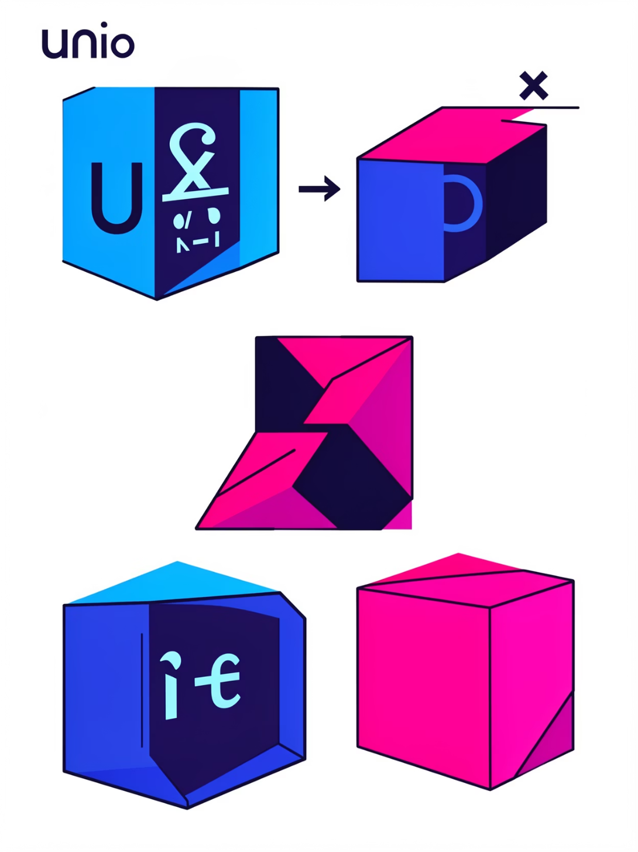
Sets & set operations
- Use sets for unique items and fast membership checks (O(1)). - Operations: union (|), intersection (&), difference (-), symmetric_difference(^). - Practical uses: deduplicating lists, filtering, and quick comparisons between collections.
Time complexity: All set operations (union, intersection, difference) are O(n+m) where n and m are set sizes.
Memory note: Sets use hash tables internally, so memory overhead is higher than lists but worth it for O(1) membership.
Advanced tip: frozenset is immutable and hashable—use it as dict keys or set members.

Slide 5
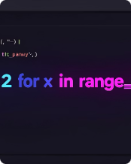
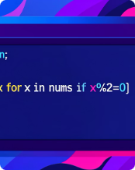
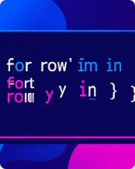
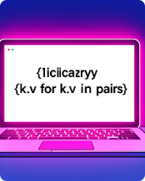
List & Dictionary Comprehensions — Write expressive code
Basic list comprehension
Conditional comprehensions
Nested comprehensions
Dictionary comprehensions
Transform and build lists in one readable line: [x*2 for x in range(5)]. O(n) time, creates new list in memory
Filter while building: [x for x in nums if condition]. Keep conditions simple. Still O(n) but filters during iteration—more efficient than filter() + list()
Flatten or transform nested lists carefully — prefer loops if readability suffers. O(n*m) for nested loops. Readability matters more than micro-optimization here.
Create dicts succinctly: {k: v for k, v in items} — useful for mapping and quick lookups. O(n) time. Faster than dict() constructor for large transformations.

Slide 6
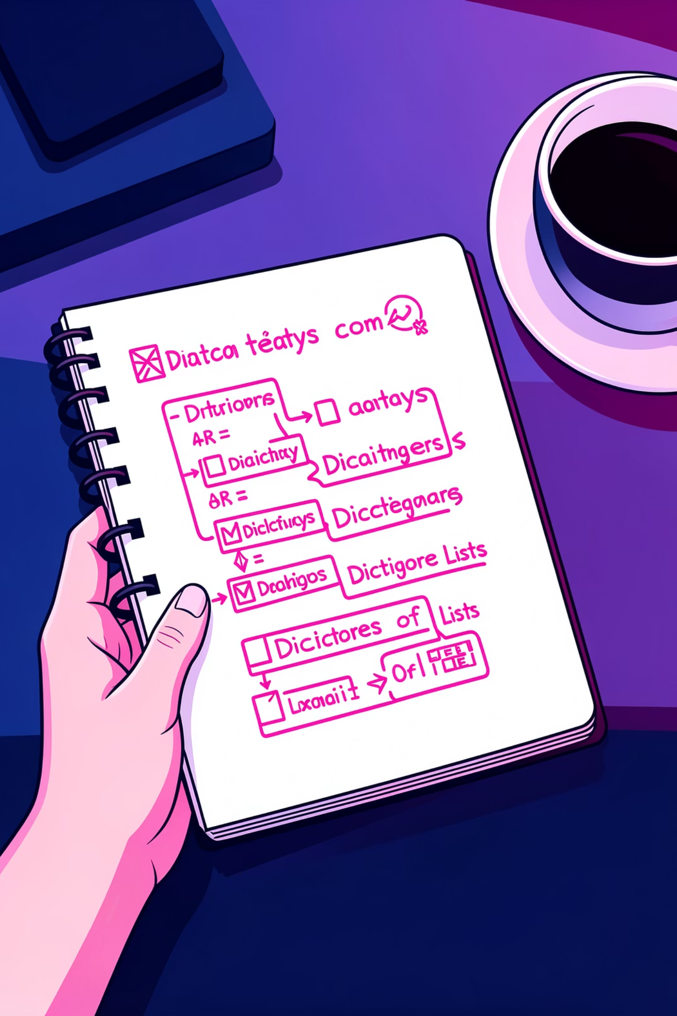
Working with Complex / Nested Data
Patterns: list of dicts (records), dict of lists (grouped attributes), deeply nested JSON.
Tips: validate shapes, use helper functions to traverse, and keep small test examples.
Example: sort a list of dicts by key: sorted(data, key=lambda d: d['score']).
Time complexity: Accessing nested data is O(1) per level if using dicts, O(n) if searching lists.
Validation pattern: Use try/except or .get() with defaults to handle missing keys gracefully.
Advanced: Consider dataclasses or Pydantic for type-safe nested structures in production code.

Slide 7
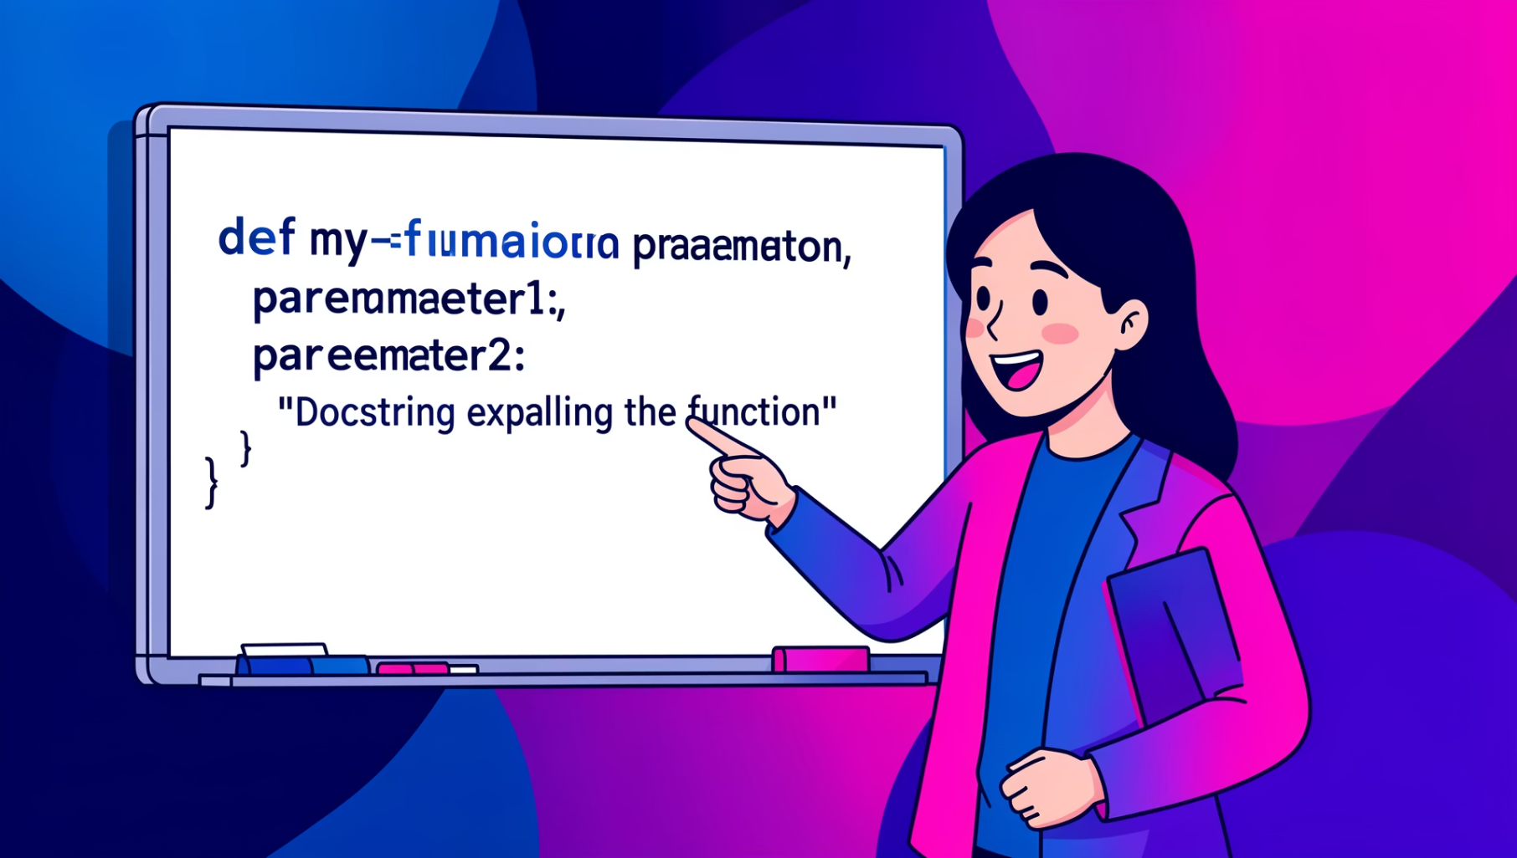
Functions — Definition & best practices
Define with def name(params):. Return values with return; functions can return tuples.
Use default parameters to simplify calls: def greet(name, prefix='Hi'):.
Always add a concise docstring explaining purpose, parameters, and return value.
Call overhead: Function calls have small overhead; avoid micro-optimizing unless profiling shows it matters.
Return optimization: Returning tuples is efficient—Python unpacks them without extra copies.
Docstring format: Follow PEP 257 or Google style for consistency across teams.

Slide 8
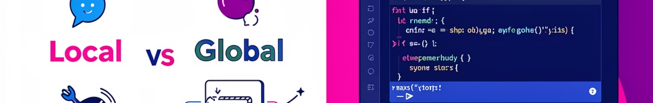
Advanced Function Concepts
Scope
Lambda functions
Local variables live inside functions. Avoid mutating globals; prefer arguments and return values. LEGB rule: Local → Enclosing → Global → Built-in. Use nonlocal/global sparingly.
Small anonymous functions: lambda x: x*2. Good for short callbacks, not for complex logic. Lambda is syntactic sugar for def. Performance is identical; use for readability only.
*args & **kwargs
Higher-order functions
Flexible signatures: def f(*args, **kwargs): handle variable positional and keyword arguments. *args is a tuple, **kwargs is a dict. Useful for decorators and flexible APIs.
Functions that take or return functions. Use map, filter, and sorted(key=...) for concise transforms. map/filter return iterators (lazy evaluation). Use list() to materialize if needed.

Slide 9

Problem
Recursive step
Base case
Recursion breaks a problem into smaller instances and requires a base case to stop. Tip: trace small inputs, watch recursion depth, and prefer iteration when clearer or more efficient. Example: factorial(n) = n * factorial(n-1) with base case factorial(0)=1.
Time complexity: Depends on the problem. Factorial is O(n), but memoization can reduce redundant calls.
Stack depth: Python has a default recursion limit (~1000). Use sys.setrecursionlimit() carefully or switch to iteration.
Tail recursion: Python doesn't optimize tail calls, so iterative solutions are often faster and safer.
Memoization example: Use @functools.lru_cache to cache results and avoid recalculating.

Slide 10

Key Takeaways & Next Steps
1
Pick the right structure
2
Prefer clarity
3
Build reusable functions
Use dicts for mappings, lists for sequences, sets for uniqueness.
Choose comprehensions for concise transforms, but not at the cost of readability.
Document behavior, handle edge cases, and keep signatures simple.
Practice exercises: build a contacts list (list of dicts), deduplicate with sets, and implement a recursive and iterative factorial. Want slides adapted for a live workshop? Ask and I’ll tailor examples and exercises.

